Slide 1
Putting SQL to Work
MoAD
Mahesh S Patil

Slide 2
SQLite
SQLite1 is a tiny yet powerful database engine created by Dr. Richard Hipp in 2000.
small embedded engines included with the Android platform.
It’s free, small(150KB) and requires no setup or administration. There is no server, no config file, and no need for a database administrator
A SQLite database is just a file

Slide 3
Tables for demo
weather
_ID location_id date weather_id short_desc min max humidity pressure wind Degrees
location
_ID location_setting city_name coord_lat coord_long

Slide 4
SQLite
Database – Package
The main package is android.database.sqlite that contains the classes to manage your own databases
Database - Creation
In order to create a database you just need to call this method openOrCreateDatabase with your database name and mode as a parameter. It returns an instance of SQLite database which you have to recieve in your own object.Its syntax is given below
SQLiteDatabse mydatabase = openOrCreateDatabase("your database name",MODE_PRIVATE,null);

Slide 5
Database - Creation Methods
S.No | Method & Description
1 | openDatabase(String path, SQLiteDatabase.CursorFactory factory, int flags, DatabaseErrorHandler errorHandler) This method only opens the existing database with the appropriate flag mode. The common flags mode could be OPEN_READWRITE OPEN_READONLY
2 | openDatabase(String path, SQLiteDatabase.CursorFactory factory, int flags) It is similar to the above method as it also opens the exisiting database but it does not define any handler to handle the errors of databases
3 | openOrCreateDatabase(String path, SQLiteDatabase.CursorFactory factory) It not only opens but create the datbase if it not exists. This method is equivalent to openDatabase method
4 | openOrCreateDatabase(File file, SQLiteDatabase.CursorFactory factory) This method is similar to above method but it takes the File object as a path rather then a string. It is equavilent to file.getPath()

Slide 6
Database - Insertion
We can create table or insert data into table using execSQL method defined in SQLiteDatabase class. Its syntax is given below
mydatabase.execSQL("CREATE TABLE IF NOT EXISTS TutorialsPoint(Username VARCHAR,Password VARCHAR);");
mydatabase.execSQL("INSERT INTO TutorialsPoint VALUES('admin','admin');");
This will insert some values into our table in our database. Another method that also does the same job but take some additional parameter is given below
execSQL(String sql, Object[] bindArgs)
This method not only insert data , but also used to update or modify already existing data in database using bind arguments

Slide 7
Database - Fetching
We can retrieve anything from datbase using an object of the Cursor class. We will call a method of this class called rawQuery and it will return a resultset with the cursor pointing to the table. We can move the cursor forward and retrieve the data.
Cursor resultSet = mydatbase.rawQuery("Select * from TutorialsPoint",null); resultSet.moveToFirst();
String username = resultSet.getString(1);
String password = resultSet.getString(2);

Slide 8
Cursor Methods
S.No | Method & Description
1 | getColumnCount() This method return the total number of columns of the table.
2 | getColumnIndex(String columnName) This method returns the index number of a column by specifying the name of the column
3 | getColumnName(int columnIndex) This method returns the name of the column by specifying the index of the column
4 | getColumnNames() This method returns the array of all the column names of the table.
5 | getCount() This method returns the total number of rows in the cursor
6 | getPosition() This method returns the current position of the cursor in the table

Slide 9
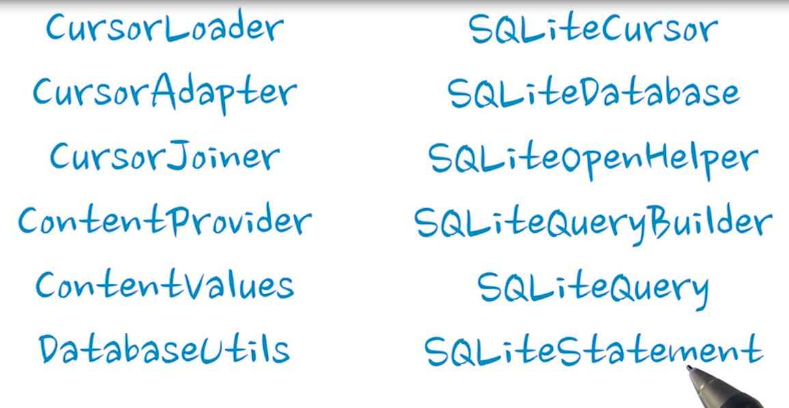
Classes and interfaces

Slide 10
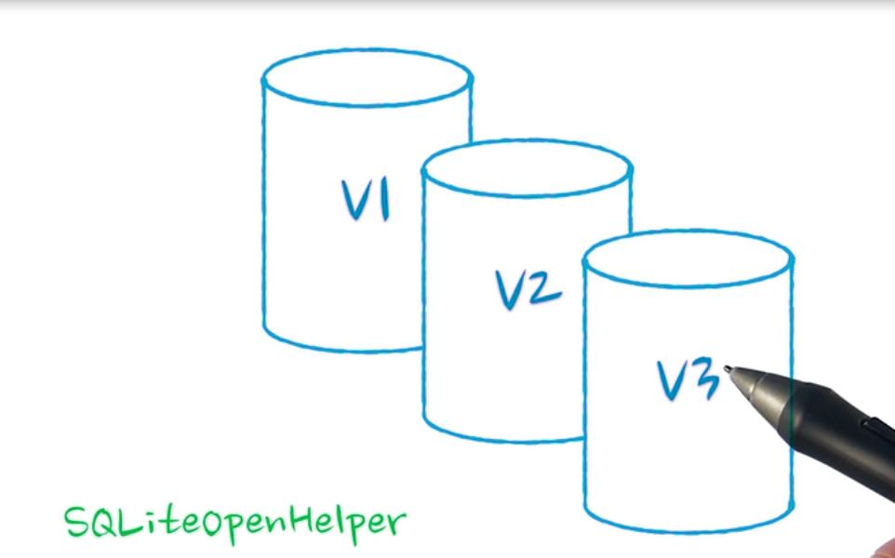
DB versions

Slide 11
android.provider.BaseColumns
Used for creating constants that describes database
Ex:
public static final class WeatherEntry implements BaseColumns { public static final String TABLE_NAME = "weather"; // Column with the foreign key into the location table. public static final String COLUMN_LOC_KEY = "location_id"; // Date, stored as long in milliseconds since the epoch public static final String COLUMN_DATE = "date"; // Weather id as returned by API, to identify the icon to be used public static final String COLUMN_WEATHER_ID = "weather_id"; // Short description and long description of the weather, as provided by API. // e.g "clear" vs "sky is clear". public static final String COLUMN_SHORT_DESC = "short_desc";
:
:
Column name ending with _id is the primary key. This is help for content provider

Slide 12
Using SQLiteOpenHelper
Its helper class used to represent the database
Extend this class, add constructor and override two methods
onCreate()
onUpgrade()
Oncreate() will be run when database is accessed and it finds database doesn’t exist.
onUpgrade() runs when you change to new version of database

Slide 13
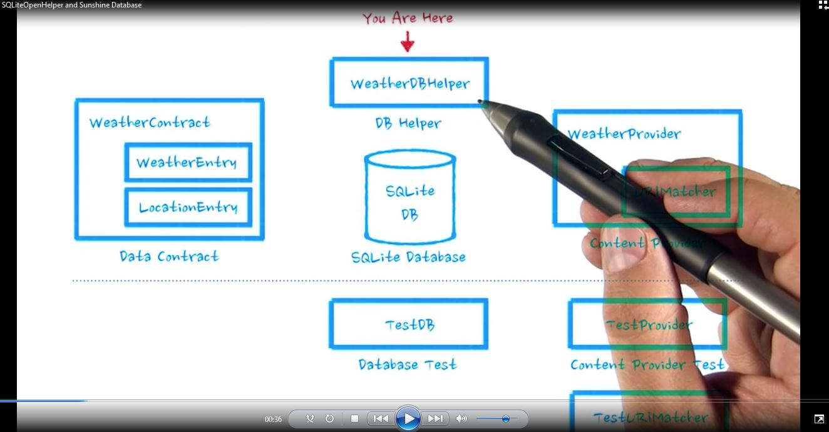

Slide 14
Demo
Steps | Instructions
1 | Create a package “data”
2 | Create a class WeatherContract.java in data package.
3 | Then create two inner subclasses of BaseColumns. i.e LocationEntry and WeatherEntry. public class LocationEntry implements BaseColumns { // Table name public static final String TABLE_NAME="location"; // The location setting string is what will be sent to openweathermap // as the location query. public static final String COLUMN_LOCATION_SETTING = "location_setting"; // Human readable location string, provided by the API. Because for styling, // "Mountain View" is more recognizable than 94043. public static final String COLUMN_CITY_NAME = "city_name"; // In order to uniquely pinpoint the location on the map when we launch the // map intent, we store the latitude and longitude as returned by openweathermap. public static final String COLUMN_COORD_LAT = "coord_lat"; public static final String COLUMN_COORD_LONG = "coord_long"; }

Slide 15
Demo
Steps | Instructions
3 | public static final class WeatherEntry implements BaseColumns { public static final String TABLE_NAME = "weather"; // Column with the foreign key into the location table. public static final String COLUMN_LOC_KEY = "location_id"; // Date, stored as long in milliseconds since the epoch public static final String COLUMN_DATE = "date"; // Weather id as returned by API, to identify the icon to be used public static final String COLUMN_WEATHER_ID = "weather_id"; // Short description and long description of the weather, as provided by API. // e.g "clear" vs "sky is clear". public static final String COLUMN_SHORT_DESC = "short_desc"; // Min and max temperatures for the day (stored as floats) public static final String COLUMN_MIN_TEMP = "min"; public static final String COLUMN_MAX_TEMP = "max"; // Humidity is stored as a float representing percentage public static final String COLUMN_HUMIDITY = "humidity"; // Humidity is stored as a float representing percentage public static final String COLUMN_PRESSURE = "pressure"; // Windspeed is stored as a float representing windspeed mph public static final String COLUMN_WIND_SPEED = "wind"; // Degrees are meteorological degrees (e.g, 0 is north, 180 is south). Stored as floats. public static final String COLUMN_DEGREES = "degrees"; }

Slide 16
Demo
Steps | Instructions
4 | Now create subclass of SQLiteOpenHelper, WeatherDbHelper. Here you need to import WeatherContract.LocationEntry and WeatherContract.WeatherEntry
5 | Declare members and Add constructor in WeatherDbHelper. private static final int DATABASE_VERSION = 1; public static final String DATABASE_NAME = "weather.db"; public WeatherDbHelper(Context context){ super(context, DATABASE_NAME, null, DATABASE_VERSION); }
6 | Override onCreate() and onUpgrade(). Next in the onCreate() method create tables as shown in below code. public void onCreate(SQLiteDatabase sqLiteDatabase) { // Create a table to hold locations. A location consists of the string supplied in the // location setting, the city name, and the latitude and longitude final String SQL_CREATE_LOCATION_TABLE = "CREATE TABLE " + LocationEntry.TABLE_NAME + " (" + LocationEntry._ID + " INTEGER PRIMARY KEY," + LocationEntry.COLUMN_LOCATION_SETTING + " TEXT UNIQUE NOT NULL, " + LocationEntry.COLUMN_CITY_NAME + " TEXT NOT NULL, " + LocationEntry.COLUMN_COORD_LAT + " REAL NOT NULL, " + LocationEntry.COLUMN_COORD_LONG + " REAL NOT NULL " + " );";

Slide 17
Demo
Steps | Instructions
6 | final String SQL_CREATE_WEATHER_TABLE = "CREATE TABLE " + WeatherContract.WeatherEntry.TABLE_NAME + " (" + // Why AutoIncrement here, and not above? // Unique keys will be auto-generated in either case. But for weather // forecasting, it's reasonable to assume the user will want information // for a certain date and all dates *following*, so the forecast data // should be sorted accordingly. WeatherContract.WeatherEntry._ID + " INTEGER PRIMARY KEY AUTOINCREMENT," + // the ID of the location entry associated with this weather data WeatherEntry.COLUMN_LOC_KEY + " INTEGER NOT NULL, " + WeatherEntry.COLUMN_DATE + " INTEGER NOT NULL, " + WeatherEntry.COLUMN_SHORT_DESC + " TEXT NOT NULL, " + WeatherEntry.COLUMN_WEATHER_ID + " INTEGER NOT NULL," + WeatherEntry.COLUMN_MIN_TEMP + " REAL NOT NULL, " + WeatherEntry.COLUMN_MAX_TEMP + " REAL NOT NULL, " + WeatherEntry.COLUMN_HUMIDITY + " REAL NOT NULL, " + WeatherEntry.COLUMN_PRESSURE + " REAL NOT NULL, " + WeatherEntry.COLUMN_WIND_SPEED + " REAL NOT NULL, " + WeatherEntry.COLUMN_DEGREES + " REAL NOT NULL, " + // Set up the location column as a foreign key to location table. " FOREIGN KEY (" + WeatherEntry.COLUMN_LOC_KEY + ") REFERENCES " + LocationEntry.TABLE_NAME + " (" + LocationEntry._ID + "), " + // To assure the application have just one weather entry per day // per location, it's created a UNIQUE constraint with REPLACE strategy " UNIQUE (" + WeatherEntry.COLUMN_DATE + ", " + WeatherContract.WeatherEntry.COLUMN_LOC_KEY + ") ON CONFLICT REPLACE);"; sqLiteDatabase.execSQL(SQL_CREATE_LOCATION_TABLE); sqLiteDatabase.execSQL(SQL_CREATE_WEATHER_TABLE); }

Slide 18
Demo
Steps | Instructions
7 | Now create Activity DbTest1Activity.java . Include following members final String LOG_CAT=DbTest1Activity.class.getSimpleName(); SQLiteDatabase db; static final String TEST_LOCATION = "99705";
8 | Now test if database can be opened. Add following try block in onCreate() method. In this demo everytime database tables are deleted. Check the code here try { //DELETE EXISTING DATABASE getApplicationContext().deleteDatabase(WeatherDbHelper.DATABASE_NAME); Log.i(LOG_CAT, "yet to create db "); db = new WeatherDbHelper(getApplicationContext()).getWritableDatabase(); //check db exists or created if (db.isOpen()) Log.i(LOG_CAT, "db is open"); }catch (Exception e){ Log.i(LOG_CAT, e.getMessage()); } db.close();
9 | Now run the app check the log. You should see the message "db is open“.

Slide 19
Demo
Steps | Instructions
10 | Once the DB is open, further add code to check tables created. Use following code and include it in the try{} block. Then run app and check log for mesaages. //check table is created Cursor c = db.rawQuery("SELECT name FROM sqlite_master WHERE type='table'", null); if (c.moveToFirst()) { Log.i(LOG_CAT, "tables created= " + c.getString(0)); } do { Log.i(LOG_CAT, "table = " + c.getString(0)); } while (c.moveToNext());
11 | Next create two methods in activity DbTest1Activity to insert a row and query the table location void addRow(){ ContentValues testValues = new ContentValues(); testValues.put(WeatherContract.LocationEntry.COLUMN_LOCATION_SETTING, TEST_LOCATION); testValues.put(WeatherContract.LocationEntry.COLUMN_CITY_NAME, "North Pole"); testValues.put(WeatherContract.LocationEntry.COLUMN_COORD_LAT, 64.7488); testValues.put(WeatherContract.LocationEntry.COLUMN_COORD_LONG, -147.353); //Insert ContentValues into database and get a row ID back long locationRowId; locationRowId = db.insert(WeatherContract.LocationEntry.TABLE_NAME, null, testValues); // Verify we got a row back. if(locationRowId != -1) Log.i(LOG_CAT,"location table row added"); else Log.i(LOG_CAT,"adding row failed location table"); }

Slide 20
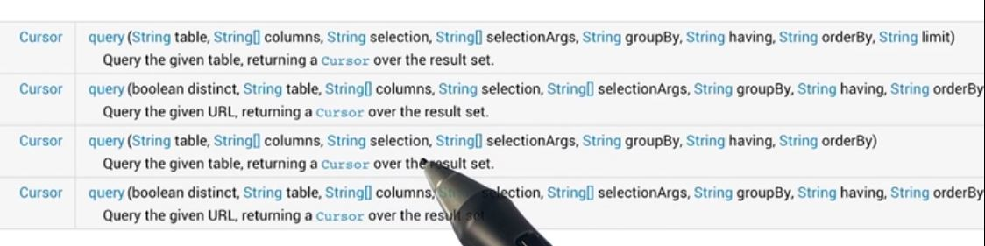
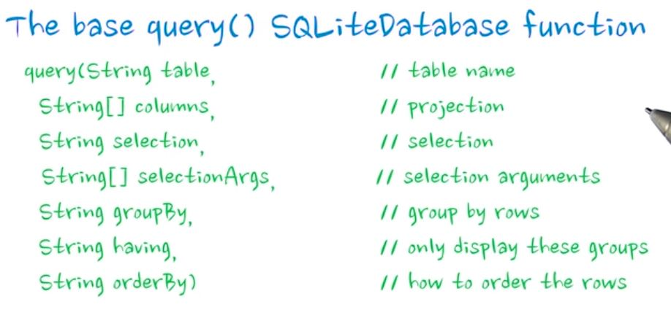

Slide 21
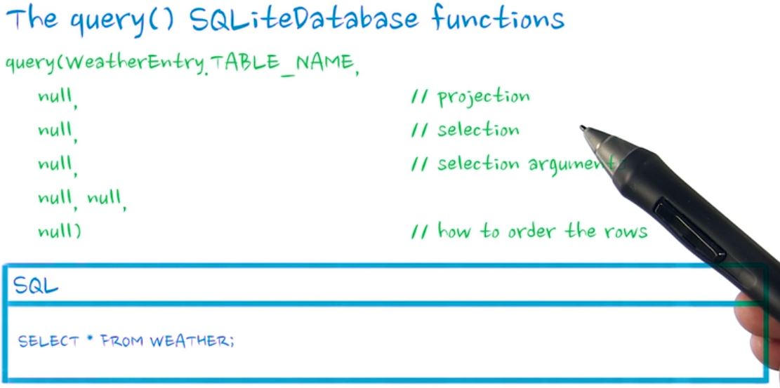

Slide 22
Demo
Steps | Instructions
11 | Cursor getAllRowsOfLocationTable(){ // Query the database and receive a Cursor back // A cursor is your primary interface to the query results. Cursor cursor = db.query( WeatherContract.LocationEntry.TABLE_NAME, // Table to Query null, // all columns null, // Columns for the "where" clause null, // Values for the "where" clause null, // columns to group by null, // columns to filter by row groups null // sort order ); return cursor; }
12 | Then include following code in try{} as you did in previously. Run the app and check log. //now adding a row through user defined method addRow(); //query location table through user defined method Cursor c2=getAllRowsOfLocationTable(); c2.moveToFirst(); Log.i(LOG_CAT, "table = Location rows as follows"); do { Log.i(LOG_CAT, "id="+c2.getInt(0)+"setting= "+c2.getString(1)+" city name="+c2.getString(2) +" latitude="+c2.getDouble(3)+" longitude="+c2.getDouble(4)); } while (c.moveToNext());

Slide 23
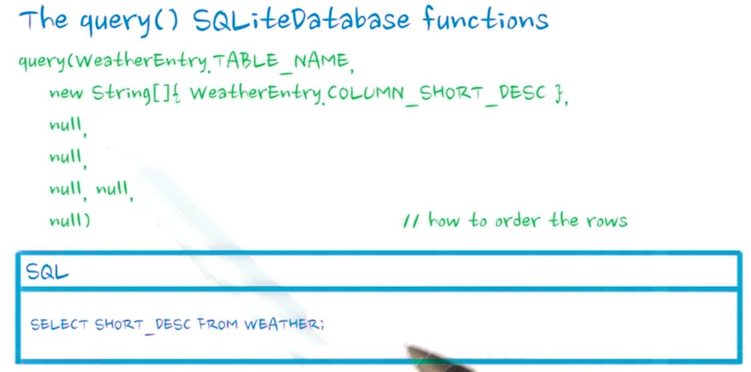

Slide 24
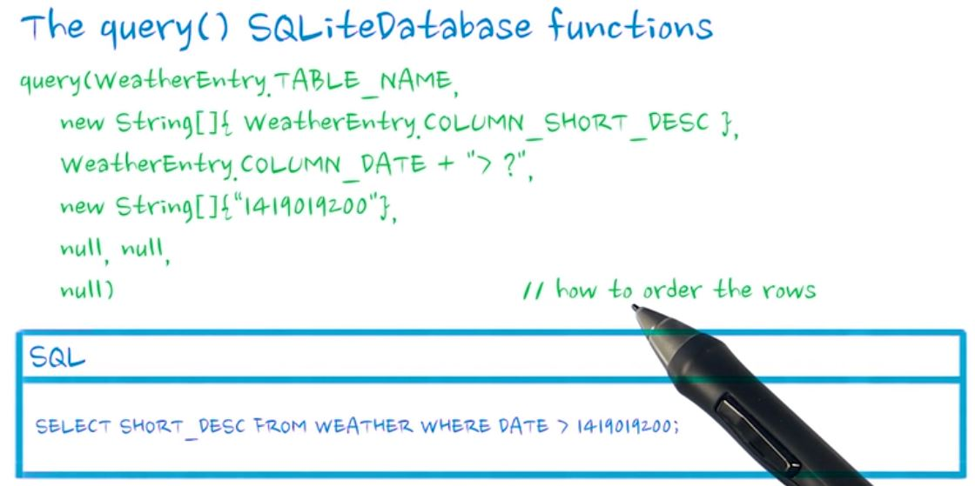

Slide 25
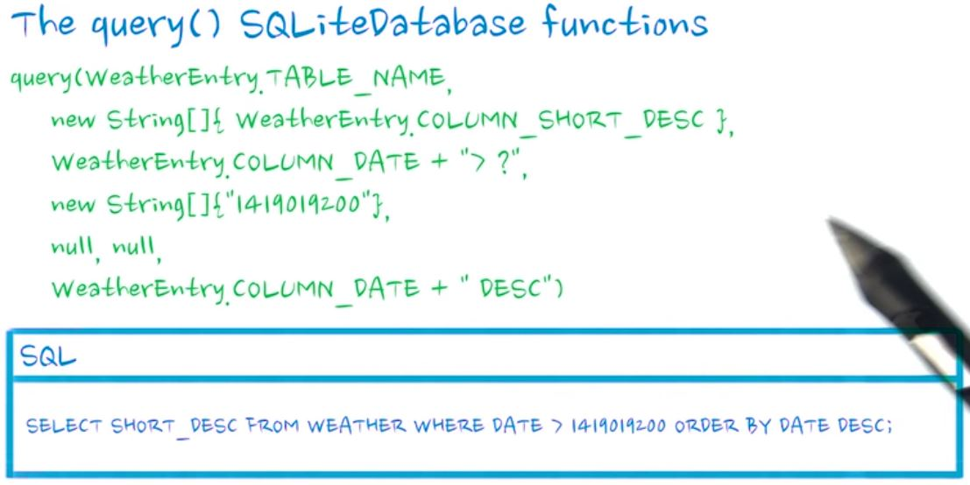

Slide 26
Cloud connect
Android lets your application connect to the internet or any other local network and allows you to perform network operations.
Checking Network Connection
Before you perform any network operations, you must first check that are you connected to that network or internet
ConnectivityManager check = (ConnectivityManager) this.context.getSystemService(Context.CONNECTIVITY_SERVICE);

Slide 27
Checking Network Connection
Once you instantiate the object of ConnectivityManager class, you can use getAllNetworkInfo method to get the information of all the networks.
NetworkInfo[] info = check.getAllNetworkInfo();
The last thing you need to do is to check Connected State of the network. Its syntax is given below −

Slide 28
Performing Network Operations
Android provides HttpURLConnection and URL class to fetch responses. Here we are fetching the html of a website from a url.
String link = "http://www.google.com";
URL url = new URL(link);
After that you need to call openConnection method of url class and receive it in a HttpURLConnection object. After that you need to call the connect method of HttpURLConnection class.
HttpURLConnection conn = (HttpURLConnection) url.openConnection();
conn.connect();

Slide 29
Performing Network Operations
And the last thing you need to do is to fetch the HTML from the website. For this you will use InputStream and BufferedReader class. Its syntax is given below −
InputStream is = conn.getInputStream(); BufferedReader reader = new BufferedReader(new InputStreamReader(is, "UTF-8")); String webPage = "",data=""; while ((data = reader.readLine()) != null){ webPage += data + "\n"; }

Slide 30
HttpURLConnection Method
 | Method & description
1 | disconnect() This method releases this connection so that its resources may be either reused or closed
2 | getRequestMethod() This method returns the request method which will be used to make the request to the remote HTTP server
3 | getResponseCode() This method returns response code returned by the remote HTTP server
4 | setRequestMethod(String method) This method Sets the request command which will be sent to the remote HTTP server
5 | usingProxy() This method returns whether this connection uses a proxy server or not

Slide 31
Cloud connect
Select a open weather API and try it in the browser to see the json string
Sample API
api.openweathermap.org/data/2.5/weather?q={city name},{country code}
API with param
http://api.openweathermap.org/data/2.5/weather?q={Hubli},{IN}&APPID=11111111111

Slide 32
Cloud connect
How to use API key in API call
Description:
To get access to weather API you need an API key whatever account you chose from Free to Enterprise.
We keep right to not to process API requests without API key.
API call:
http://api.openweathermap.org/data/2.5/forecast/city?id=524901&APPID={APIKEY}
Parameters:
APPID {APIKEY} is your unique API key
Example of API call:
api.openweathermap.org/data/2.5/forecast/city?id=524901&APPID=1111111111

Slide 33
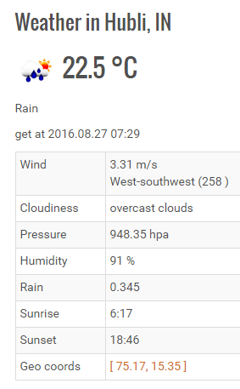
Cloud connect

Slide 34
Cloud connect
Sample API's
Call current weather data for one location
By city name
Description:
You can call by city name or city name and country code. API responds with a list of results that match a searching word.
API call:
api.openweathermap.org/data/2.5/weather?q={city name}
api.openweathermap.org/data/2.5/weather?q={city name},{country code}
Parameters:
q city name and country code divided by comma, use ISO 3166 country codes
Examples of API calls:
api.openweathermap.org/data/2.5/weather?q=London
api.openweathermap.org/data/2.5/weather?q=London,uk

Slide 35
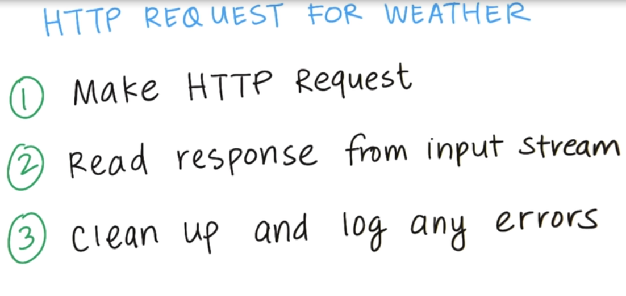
Cloud connect

Slide 36
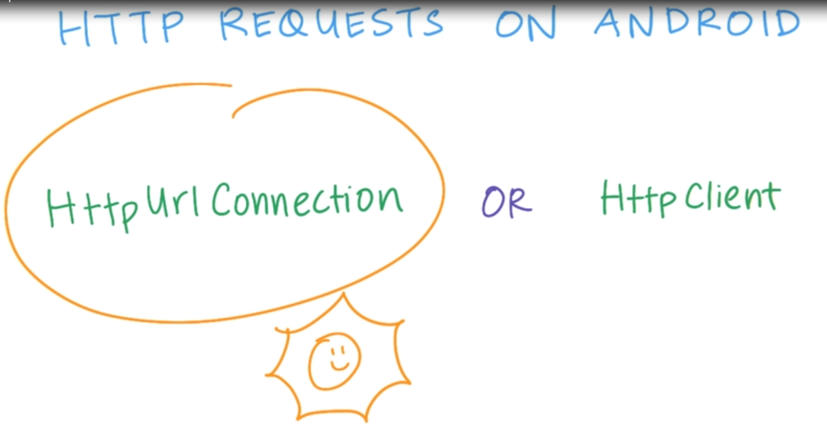
Cloud connect
General purpose
Lightweight
Optimized for most Android Apps

Slide 37


Cloud connect
Permission in Android manifest.xml
<uses-permission android:name="android.permission.INTERNET" />

Slide 38
Cloud connect: AsyncTask
This class allows to perform background operations and publish results on the UI thread without having to manipulate threads and/or handlers.
AsyncTask is designed to be a helper class around Thread and Handler and does not constitute a generic threading framework.
AsyncTasks should ideally be used for short operations

Slide 39
Cloud connect: AsyncTask
The 4 steps
onPreExecute(), invoked on the UI thread before the task is executed.
doInBackground(Params...), invoked on the background thread immediately after onPreExecute() finishes executing.
onProgressUpdate(Progress...), invoked on the UI thread after a call to publishProgress(Progress...).
onPostExecute(Result), invoked on the UI thread after the background computation finishes.

Slide 40
HTTP Demo
Steps | Instructions
1 | Add following permission in manifeast.xml <uses-permission android:name="android.permission.INTERNET" />
2 | Create an activity httpRequestActivity.java with following members. Its corresponding layout would be activity_http_request.xml URL url; HttpURLConnection urlConnection = null; BufferedReader reader = null; String forecastJsonStr = "json"; String LOG_CAT; String data="nothing"; TextView weatherDataTextView_ref;
3 | Add a TextView with id: weatherDataTV_id into the layout
4 | Create a inner class featchWeatherAsynchin httpRequestActivity class . class featchWeatherAsynch extends AsyncTask<Void,Void,Void>{ @Override protected Void doInBackground(Void... params) { } @Override protected void onPostExecute(Void aVoid) { super.onPostExecute(aVoid); weatherDataTextView_ref.setText(forecastJsonStr); } }

Slide 41
HTTP Demo
Steps | Instructions
4 | Create a inner class featchWeatherAsynchin httpRequestActivity class . class featchWeatherAsynch extends AsyncTask<Void,Void,Void>{ @Override protected Void doInBackground(Void... params) { } @Override protected void onPostExecute(Void aVoid) { super.onPostExecute(aVoid); weatherDataTextView_ref.setText(forecastJsonStr); } }
5 | Update onCreate() method with following code. LOG_CAT=httpRequestActivity.class.getSimpleName(); weatherDataTextView_ref=(TextView) findViewById(R.id.weatherDataTV_id);
6 | Override onStart() method and add following code to it. Then run the app and for errors if any. featchWeatherAsynch background = new featchWeatherAsynch(); background.execute();

Slide 42
HTTP Demo
Steps | Instructions
7 | Now add following try{ } block into doInBackground() Method. try { } catch (MalformedURLException e){ Log.e(LOG_CAT, "url exception"); Log.e(LOG_CAT, e.toString()); } catch (IOException e) { Log.e(LOG_CAT, "Error ", e); e.printStackTrace(); // If the code didn't successfully get the weather data, there's no point in attemping // to parse it. data="code didn't successfully get the weather data"; //return data; } finally{ if (urlConnection != null) { urlConnection.disconnect(); } if (reader != null) { try { reader.close(); } catch (final IOException e) { Log.e(LOG_CAT, "Error closing stream", e); e.printStackTrace(); } } }

Slide 43
HTTP Demo
Steps | Instructions
8 | Add following code to try{ } block and run the app. Check for errors if any. //Replace the API key i.e &APPID=? url = new URL("http://api.openweathermap.org/data/2.5/weather?q=hubli,IN&APPID=111111111111111111111111"); urlConnection = (HttpURLConnection) url.openConnection(); urlConnection.setRequestMethod("GET"); urlConnection.connect();
9 | Further update the try{ } block with following code. // Read the input stream into a String InputStream inputStream = urlConnection.getInputStream(); StringBuffer buffer = new StringBuffer(); if (inputStream == null) { // Nothing to do. data="input stream null"; //return data; } reader = new BufferedReader(new InputStreamReader(inputStream));

Slide 44
HTTP Demo
Steps | Instructions
9 | String line; while ((line = reader.readLine()) != null) { // Since it's JSON, adding a newline isn't necessary (it won't affect parsing) // But it does make debugging a *lot* easier if you print out the completed // buffer for debugging. buffer.append(line + "\n"); } if (buffer.length() == 0) { // Stream was empty. No point in parsing. data="Stream was empty. No point in parsing"; //return data; } forecastJsonStr = buffer.toString();

Slide 45
Content Provider
A content provider component supplies data from one application to others on request. Such requests are handled by the methods of the ContentResolver class.
The data may be stored in the file system, the database or somewhere else entirely.
sometimes it is required to share data across applications. This is where content providers become very useful.
Content providers let you centralize content in one place and have many different applications access it as needed.
A content provider is implemented as a subclass of ContentProvider class and must implement a standard set of APIs that enable other applications to perform transactions.
public class MyContentProvider extends ContentProvider { }

Slide 46
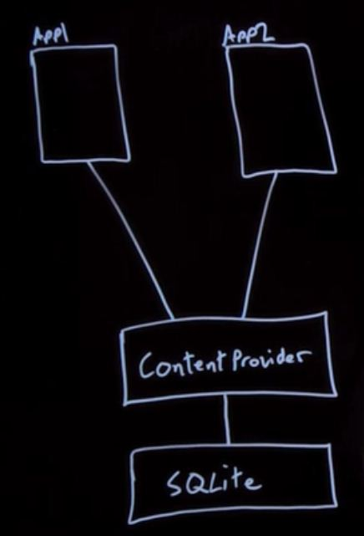
Content Provider

Slide 47
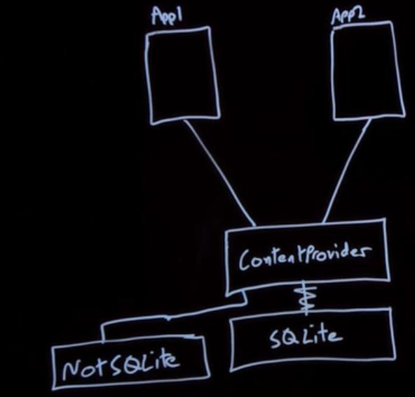
Content Provider

Slide 48
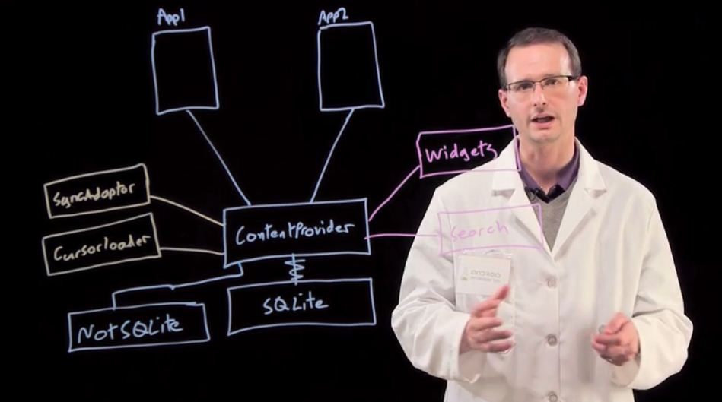
Content Provider

Slide 49
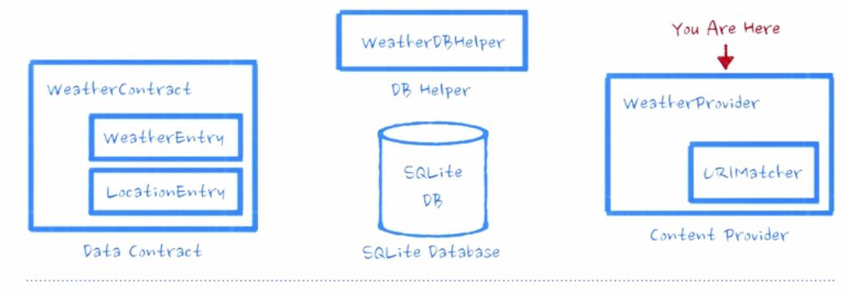
Content Provider

Slide 50
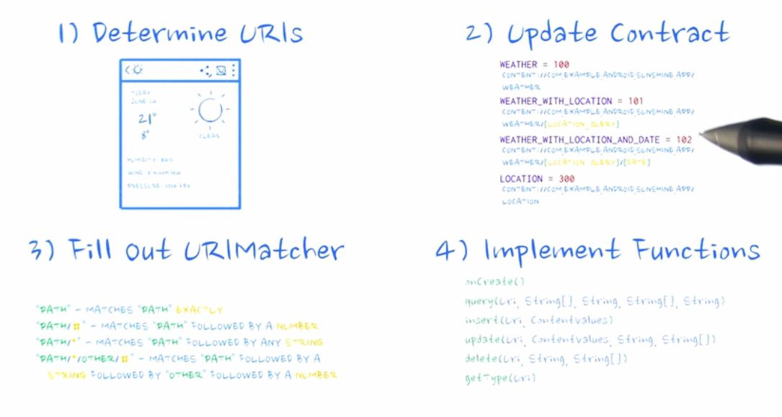
Content Provider

Slide 51
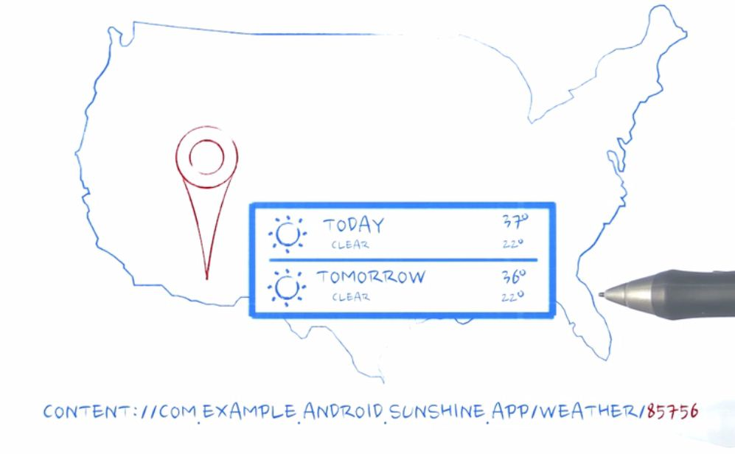
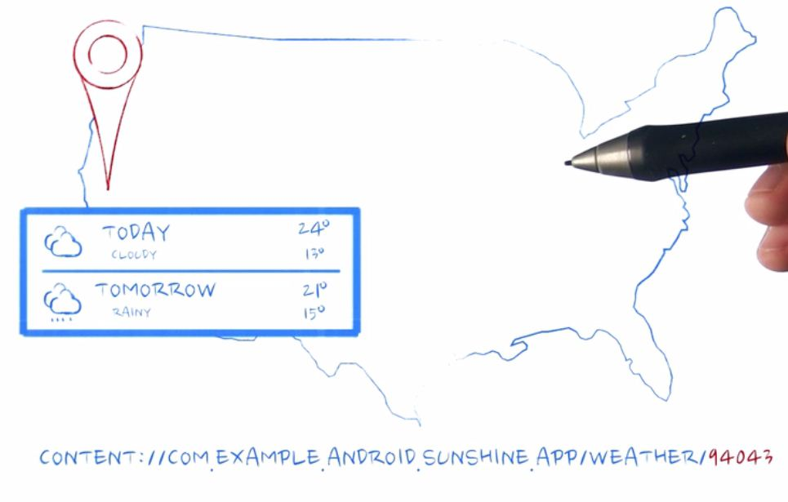
Content Provider

Slide 52
Content URIs
To query a content provider, you specify the query string in the form of a URI which has following format:
<prefix>://<authority>/<data_type>/<id>
Here is the detaial of various parts of the URI:
Part | Description
prefix | This is always set to content://
authority | This specifies the name of the content provider, for example contacts, browser etc. For third-party content providers, this could be the fully qualified name, such ascom.tutorialspoint.statusprovider
data_type | This indicates the type of data that this particular provider provides. For example, if you are getting all the contacts from the Contacts content provider, then the data path would be people and URI would look like this content://contacts/people
Id | This specifies the specific record requested. For example, if you are looking for contact number 5 in the Contacts content provider then URI would look like this content://contacts/people/5.

Slide 53
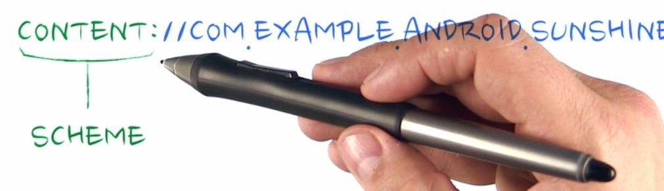
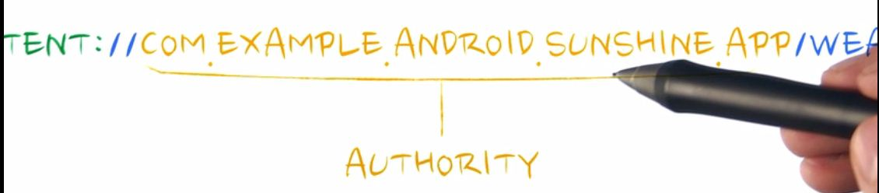
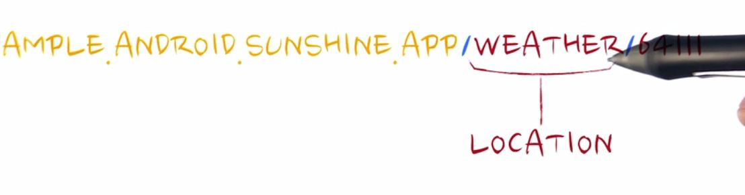
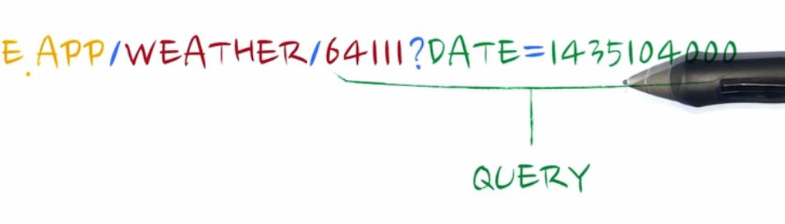
Content Provider

Slide 54
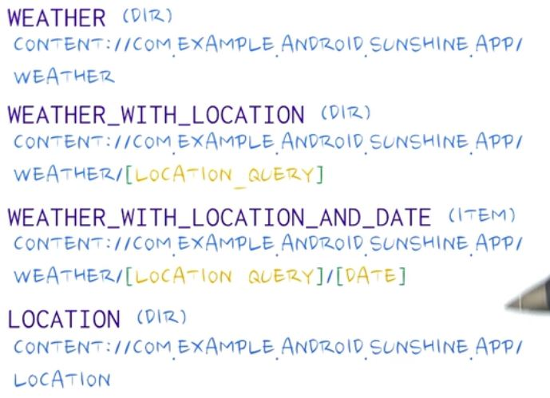
Content Provider

Slide 55
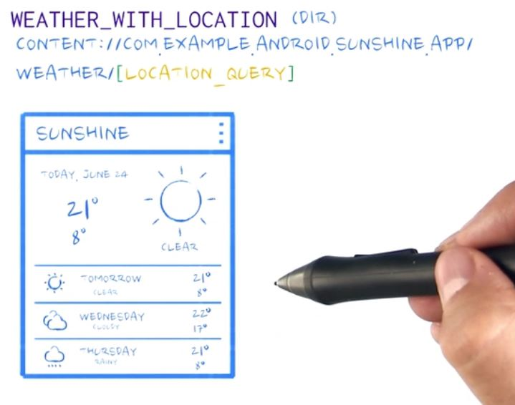
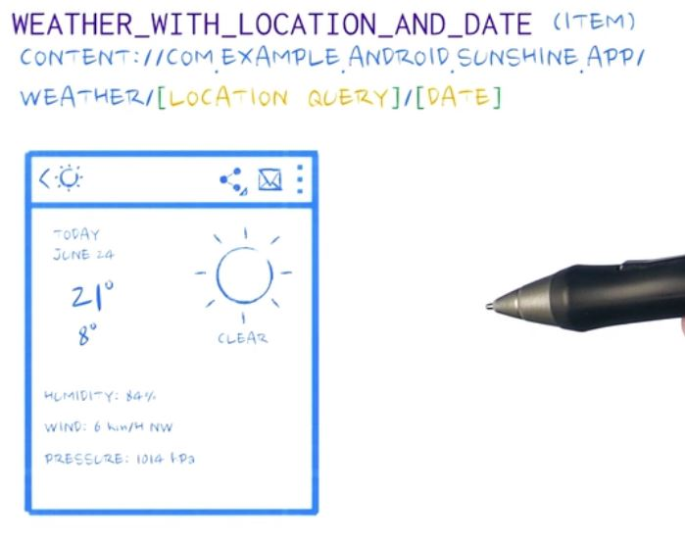
Content Provider

Slide 56
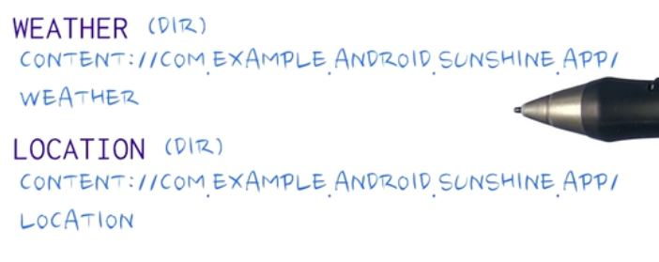
Content Provider

Slide 57
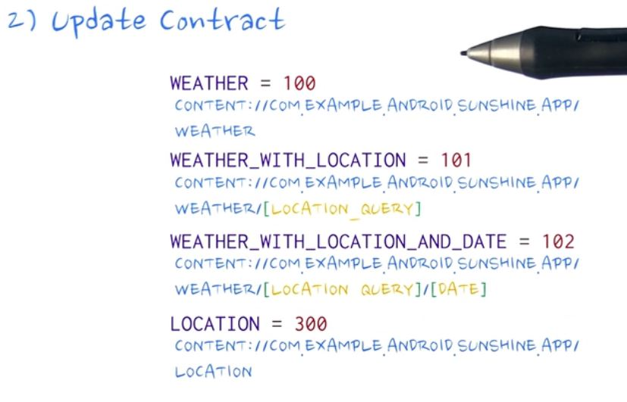
Content Provider

Slide 58
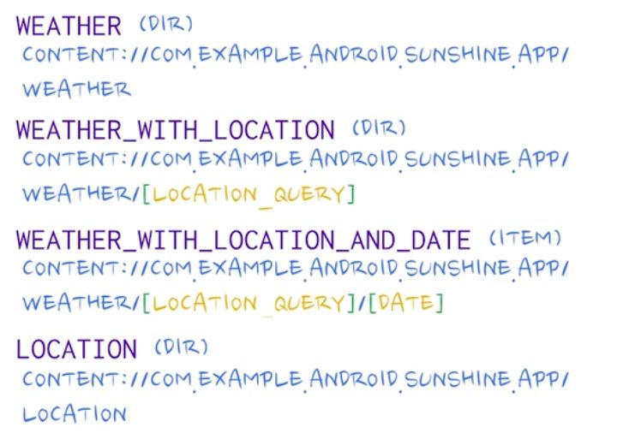
Content Provider

Slide 59
Content Provider: Demo-part 1
Steps | Instructions
1 | Create a new content provider class in the data package and override all inherited methods as shown below: public class WeatherProvider extends ContentProvider { @Override public boolean onCreate() { return false; } @Nullable @Override public Cursor query(Uri uri, String[] projection, String selection, String[] selectionArgs, String sortOrder) { return null; } @Nullable @Override public String getType(Uri uri) { return null; } @Nullable @Override public Uri insert(Uri uri, ContentValues values) { return null; } @Override public int delete(Uri uri, String selection, String[] selectionArgs) { return 0; } @Override public int update(Uri uri, ContentValues values, String selection, String[] selectionArgs) { return 0; } }

Slide 60
Content Provider: Demo-part 1
Steps | Instructions
2 | Add following member to WeatherProvider class static final int WEATHER = 100; static final int WEATHER_WITH_LOCATION = 101; static final int WEATHER_WITH_LOCATION_AND_DATE = 102; static final int LOCATION = 300;
3 | Now go to WeatherContract class and add following members // The "Content authority" is a name for the entire content provider, similar to the // relationship between a domain name and its website. A convenient string to use for the // content authority is the package name for the app, which is guaranteed to be unique on the // device. public static final String CONTENT_AUTHORITY = "bvb.android.example.com.practice2016_17"; // Use CONTENT_AUTHORITY to create the base of all URI's which apps will use to contact // the content provider. public static final Uri BASE_CONTENT_URI = Uri.parse("content://" + CONTENT_AUTHORITY); // Possible paths (appended to base content URI for possible URI's) // For instance, content://com.example.android.sunshine.app/weather/ is a valid path for // looking at weather data. content://com.example.android.sunshine.app/givemeroot/ will fail, // as the ContentProvider hasn't been given any information on what to do with "givemeroot". // At least, let's hope not. Don't be that dev, reader. Don't be that dev. public static final String PATH_WEATHER = "weather"; public static final String PATH_LOCATION = "location";

Slide 61
Content Provider: Demo-part 1
Steps | Instructions
4 | In the inner class LocationEntry , add following members public static final Uri CONTENT_URI = BASE_CONTENT_URI.buildUpon().appendPath(PATH_LOCATION).build(); public static final String CONTENT_TYPE = ContentResolver.CURSOR_DIR_BASE_TYPE +"/" + CONTENT_AUTHORITY + "/" + PATH_LOCATION; public static final String CONTENT_ITEM_TYPE = ContentResolver.CURSOR_ITEM_BASE_TYPE +"/" + CONTENT_AUTHORITY + "/" + PATH_LOCATION;
5 | Add following methods in the inner class LocationEntry public static Uri buildLocationUri(long id) { return ContentUris.withAppendedId(CONTENT_URI, id); } public static void logAllMembersAndFunctionsValues(){ Log.i("","LocationEntry class---------"); Log.i("CONTENT_URI",""+CONTENT_URI.toString()); Log.i("buildLocationUri()=",""+buildLocationUri(123456).toString()); }

Slide 62
Content Provider: Demo-part 1
Steps | Instructions
6 | Similarly add following members to the inner class WeatherEntry public static final Uri CONTENT_URI = BASE_CONTENT_URI.buildUpon().appendPath(PATH_WEATHER).build(); public static final String CONTENT_TYPE = ContentResolver.CURSOR_DIR_BASE_TYPE + "/" + CONTENT_AUTHORITY + "/" + PATH_WEATHER; public static final String CONTENT_ITEM_TYPE = ContentResolver.CURSOR_ITEM_BASE_TYPE + "/" + CONTENT_AUTHORITY + "/" + PATH_WEATHER;
7 | Also add following method to the inner class WeatherEntry public static Uri buildWeatherLocation(String locationSetting) { return CONTENT_URI.buildUpon().appendPath(locationSetting).build(); } public static Uri buildWeatherLocationWithStartDate( String locationSetting, long startDate) { long normalizedDate = normalizeDate(startDate); return CONTENT_URI.buildUpon().appendPath(locationSetting) .appendQueryParameter(COLUMN_DATE, Long.toString(normalizedDate)).build(); } public static Uri buildWeatherLocationWithDate(String locationSetting, long date) { return CONTENT_URI.buildUpon().appendPath(locationSetting) .appendPath(Long.toString(normalizeDate(date))).build(); }

Slide 63
Content Provider: Demo-part 1
Steps | Instructions
8 | public static void logAllMembersAndFunctionsValues(){ Log.i("","weatherEntry class---------"); Log.i("CONTENT_URI =",""+CONTENT_URI.toString()); Log.i("CONTENT_TYPE =",""+CONTENT_TYPE.toString()); Log.i("CONTENT_ITEM_TYPE =",""+CONTENT_ITEM_TYPE.toString()); Log.i("buildWeatherUri() =",""+buildWeatherUri(94043).toString()); Log.i("buildWeatherLocation()=",""+buildWeatherLocation("64111" ).toString()); Log.i("build We Lo st date()=",""+buildWeatherLocationWithStartDate("64111", 14351040000L ).toString()); Log.i("build We Lo date()=",""+buildWeatherLocationWithDate("64111", 14351040000L ).toString()); }
9 | Now add following method to outer class WeatherContract. Note: here use import android.text.format.Time for Time class // To make it easy to query for the exact date, we normalize all dates that go into // the database to the start of the the Julian day at UTC. public static long normalizeDate(long startDate) { // normalize the start date to the beginning of the (UTC) day Time time = new Time(); time.set(startDate); int julianDay = Time.getJulianDay(startDate, time.gmtoff); return time.setJulianDay(julianDay); }

Slide 64
Content Provider: Demo-part 1
Steps | Instructions
 | public static void logAllMembersAndFunctionsValues(){ Log.i("","WeatherContract class******"); Log.i("CONTENT_AUTHORITY=",""+CONTENT_AUTHORITY); Log.i("BASE_CONTENT_URI=",""+BASE_CONTENT_URI.toString()); LocationEntry.logAllMembersAndFunctionsValues(); WeatherEntry.logAllMembersAndFunctionsValues(); }
10 | Create an activity contentProviderTest1Activity and add following code to on create method. Then run app and check log WeatherContract.logAllMembersAndFunctionsValues();

Slide 65
Sample records insertion methods
Now we shall create methods that will help us in inserting records in to Db Tables. These can be used for further demo programs

Slide 66
Demo
Steps | Instructions
1 | Copy the code from Github. Go to WeatherContract class and copy –paste following methods public static void rawInsertTestRows(Context context) public static void rawInsertTestLocationRows(Context context,int column1,String column2, double column3,double column4) public static void rawInsertTestWeatherRows(Context context,int column1,Long column2, double column3,double column4,double column5 ,int column6,int column7,String column8,double column9,int column10) public static void logAllTableRows(Context context)
2 | Go back to contentProviderTest1Activity, and update onCreate() with following code //DELETE EXISTING DATABASE getApplicationContext().deleteDatabase(WeatherDbHelper.DATABASE_NAME); WeatherContract.rawInsertTestRows(getApplicationContext());

Slide 67


Following Steps are completed

Slide 68
Content Provider: Demo-part 2
Steps | Instructions
1 | Once data contract classes are updated with necessary field that help in composing Uri’s, next the URI matcher shall be included. This will help in matching the URI that content provider recieves. Add following field and method to WeatherProvider class // The URI Matcher used by this content provider. private static final UriMatcher sUriMatcher = buildUriMatcher(); static UriMatcher buildUriMatcher() { // I know what you're thinking. Why create a UriMatcher when you can use regular // expressions instead? Because you're not crazy, that's why. // All paths added to the UriMatcher have a corresponding code to return when a match is // found. The code passed into the constructor represents the code to return for the root // URI. It's common to use NO_MATCH as the code for this case. final UriMatcher matcher = new UriMatcher(UriMatcher.NO_MATCH); final String authority = WeatherContract.CONTENT_AUTHORITY; // For each type of URI you want to add, create a corresponding code. matcher.addURI(authority, WeatherContract.PATH_WEATHER, WEATHER); matcher.addURI(authority, WeatherContract.PATH_WEATHER + "/*", WEATHER_WITH_LOCATION); matcher.addURI(authority, WeatherContract.PATH_WEATHER + "/*/#", WEATHER_WITH_LOCATION_AND_DATE); matcher.addURI(authority, WeatherContract.PATH_LOCATION, LOCATION); return matcher; }

Slide 69
Content Provider: Demo-part 2
Steps | Instructions
2 | Content provider shall query on virtual table formed by inner join. Add following field and method to WeatherProvider class private WeatherDbHelper mOpenHelper; private static final SQLiteQueryBuilder sWeatherByLocationSettingQueryBuilder; static{ sWeatherByLocationSettingQueryBuilder = new SQLiteQueryBuilder(); //This is an inner join which looks like //weather INNER JOIN location ON weather.location_id = location._id sWeatherByLocationSettingQueryBuilder.setTables( WeatherContract.WeatherEntry.TABLE_NAME + " INNER JOIN " + WeatherContract.LocationEntry.TABLE_NAME + " ON " + WeatherContract.WeatherEntry.TABLE_NAME + "." + WeatherContract.WeatherEntry.COLUMN_LOC_KEY + " = " + WeatherContract.LocationEntry.TABLE_NAME + "." + WeatherContract.LocationEntry._ID); }
3 | Before we update query and insert methods of content provider, we shall methods to be used in these methods. That would make it modular. Add following methods to WeatherProvider class. You also need to complete next step in order fix errors with missing methods

Slide 70
Content Provider: Demo-part 2
Steps | Instructions
3 ctnd | private Cursor getWeatherByLocationSettingAndDate( Uri uri, String[] projection, String sortOrder) { Log.i("cp", "getWeatherByLocationSettingAndDate() "); String locationSetting = WeatherContract.WeatherEntry.getLocationSettingFromUri(uri); long date = WeatherContract.WeatherEntry.getDateFromUri(uri); Log.i("cp", " "+locationSetting+" "+date); return sWeatherByLocationSettingQueryBuilder.query(mOpenHelper.getReadableDatabase(), projection, sLocationSettingAndDaySelection, new String[]{locationSetting, Long.toString(date)}, null, null, sortOrder ); }

Slide 71
Content Provider: Demo-part 2
Steps | Instructions
4 | Now replace getType method. @Override public String getType(Uri uri) { // Use the Uri Matcher to determine what kind of URI this is. final int match = sUriMatcher.match(uri); switch (match) { // Student: Uncomment and fill out these two cases case WEATHER_WITH_LOCATION_AND_DATE: return WeatherContract.WeatherEntry.CONTENT_ITEM_TYPE; case WEATHER_WITH_LOCATION: return WeatherContract.WeatherEntry.CONTENT_TYPE; case WEATHER: return WeatherContract.WeatherEntry.CONTENT_TYPE; case LOCATION: return WeatherContract.LocationEntry.CONTENT_TYPE; default: throw new UnsupportedOperationException("Unknown uri: " + uri); } }

Slide 72
Content Provider: Demo-part 2
Steps | Instructions
5 | Now go to inner class WeatherContract.WeatherEntry and add following methods public static String getLocationSettingFromUri(Uri uri) { return uri.getPathSegments().get(1); } public static long getDateFromUri(Uri uri) { return Long.parseLong(uri.getPathSegments().get(2)); }
6 | Now go back to WeatherProvider class and replace the onCreate() method @Override public boolean onCreate() { mOpenHelper = new WeatherDbHelper(getContext()); return true; }

Slide 73
Content Provider: Demo-part 2
Steps | Instructions
7 | Further update query() method in WeatherProvider class as follows public Cursor query(Uri uri, String[] projection, String selection, String[] selectionArgs, String sortOrder) { // Here's the switch statement that, given a URI, will determine what kind of request it is, // and query the database accordingly. Log.i("cp", "content provider query method"); Cursor retCursor=null; switch (sUriMatcher.match(uri)) { // "weather/*/*" case WEATHER_WITH_LOCATION_AND_DATE: { Log.i("cp", "content provider query matched "+uri.toString()); retCursor = getWeatherByLocationSettingAndDate(uri, projection, sortOrder); break; } // "weather/*" case WEATHER_WITH_LOCATION: { //retCursor = getWeatherByLocationSetting(uri, projection, sortOrder); break; } // "weather" case WEATHER: { break; }

Slide 74
Content Provider: Demo-part 2
Steps | Instructions
7 cntd | // "location" case LOCATION: { break; } default: throw new UnsupportedOperationException("Unknown uri: " + uri); } //retCursor.setNotificationUri(getContext().getContentResolver(), uri); return retCursor; }

Slide 75
Content Provider: Demo-part 2
Steps | Instructions
8 | Now go back to contentProviderTest1Activity and replace the onCreate() method @Override protected void onCreate(Bundle savedInstanceState) { super.onCreate(savedInstanceState); setContentView(R.layout.activity_content_provider_test1); //DELETE EXISTING DATABASE getApplicationContext().deleteDatabase(WeatherDbHelper.DATABASE_NAME); //WeatherContract.logAllMembersAndFunctionsValues(); WeatherContract.rawInsertTestRows(getApplicationContext()); Uri uri=WeatherContract.WeatherEntry.buildWeatherLocationWithDate( "6411",new Date(2014,12,20).getTime());// December 20th, 2014 is 1419033600L new Date(2014,12,20) Log.i("contentActivity",uri.toString()); Cursor c=getContentResolver().query( uri, null, null,//"location.location_setting = ? AND date = ?" will be supplied in content provider, null,//new String[]{"6411","1419033600"} will be supplied from URI within content provider , null); StringBuffer temp; if (c.moveToFirst()) { Log.i("Db", "content provider row obtained"); do { temp=new StringBuffer(); for(int i=0;i<c.getColumnCount();i++) temp.append(" "+c.getString(i)); Log.i("Db", temp.toString()); } while (c.moveToNext()); }else Log.i("Db", "content provider failed"); }

Slide 76
Content Provider: Demo-part 2
Steps | Instructions
9 | Further update insert() method of content provider to add rows in to tables: weather and location in sqlite.

Slide 77
Sample problem statement
Consider students marks for MoAD course. The student data is stored as single in sqlite table. Create data contract and content provider for accessing the students marks of
One student with particular rollnumber
Particular division and batch
Then test the content provider through an activity

Slide 78
JSON
JSON stands for JavaScript Object Notation.It is an independent data exchange format and is the best alternative for XML.
Android provides four differnet classes to manipulate JSON data. These classes areJSONArray,JSONObject,JSONStringer and JSONTokenizer.

Slide 79
JSON - Elements
An JSON file consist of many components.
 | Component & description
1 | Array([) In a JSON file , square bracket ([) represents a JSON array
2 | Objects({) In a JSON file, curly bracket ({) represents a JSON object
3 | Key A JSON object contains a key that is just a string. Pairs of key/value make up a JSON object
4 | Value Each key has a value that could be string , integer or double e.t.c

Slide 80
JSON Methods
Sr.No | Method & description
1 | get(String name) This method just Returns the value but in the form of Object type
2 | getBoolean(String name) This method returns the boolean value specified by the key
3 | getDouble(String name) This method returns the double value specified by the key
4 | getInt(String name) This method returns the integer value specified by the key
5 | getLong(String name) This method returns the long value specified by the key
6 | length() This method returns the number of name/value mappings in this object..
7 | names() This method returns an array containing the string names in this object.

Slide 81
JSON - Parsing
For parsing a JSON object, we will create an object of class JSONObject and specify a string containing JSON data to it. Its syntax is:
String in; JSONObject reader = new JSONObject(in);
The last step is to parse the JSON. An JSON file consist of different object with different key/value pair e.t.c. So JSONObject has a seperate function for parsing each of the component of JSON file. Its syntax is given below:
JSONObject sys = reader.getJSONObject("sys"); country = sys.getString("country");
JSONObject main = reader.getJSONObject("main"); temperature = main.getString("temp");

Slide 82
JSON parsing
Your application needs to parse responses from an API or other source that are formatted in JavaScript Object Notation (JSON).
Use the org.json parser classes that are baked into Android.
Simply create a new JSONObject or JSONArray from the formatted string data
This JSON parser is strict by default, meaning that it will halt with an Exception when encountering invalid JSON data or an invalid key.
Accessor methods that prefix with ”get” will throw a JSONException if the requested value is not found.

Slide 83
JSON parsing
API
http://api.openweathermap.org/data/2.5/forecast/daily?q=Hubli&mode=json&units=metric&cnt=14&APPID=1111111111111111111111111111111111
Click to view JSON String obtained
You can copy paste JSON string in following website to view it in indented/tree format
https://jsonformatter.curiousconcept.com/

Slide 84
JSON Demo
Steps | Instructions
1 | Go back to httpRequestActivity class written in earlier Demo of cloud. Now go to the doInBackground() method inner class featchWeatherAsynch and replace following code url = new URL ("http://api.openweathermap.org/data/2.5/weather?q=hubli,IN&APPID=11111111111111111111111"); With //building Uri: http://api.openweathermap.org/data/2.5/forecast/daily?q=Hubli&mode=json&units=metric&cnt=14&APPID=1111111111111111111111111111111111 Uri builtUri = Uri.parse(FORECAST_BASE_URL).buildUpon() .appendQueryParameter("q", "Hubli") .appendQueryParameter("mode", "json") .appendQueryParameter("units", "metric") .appendQueryParameter("cnt", "14") .appendQueryParameter("APPID", "111111111111111111111111111111")//replace your API key here .build(); URL url = new URL(builtUri.toString());

Slide 85
JSON Demo
Steps | Instructions
2 | Now add following method to outer class private String getReadableDateString(long time){ // Because the API returns a unix timestamp (measured in seconds), // it must be converted to milliseconds in order to be converted to valid date. Date date = new Date(time * 1000); SimpleDateFormat format = new SimpleDateFormat("E, MMM d"); return format.format(date).toString(); } /** * Prepare the weather high/lows for presentation. */ private String formatHighLows(double high, double low) { // For presentation, assume the user doesn't care about tenths of a degree. long roundedHigh = Math.round(high); long roundedLow = Math.round(low); String highLowStr = roundedHigh + "/" + roundedLow; return highLowStr; }

Slide 86
JSON Demo
Steps | Instructions
3 | Then add following method private String[] getWeatherDataFromJson(String forecastJsonStr, int numDays) throws JSONException { // These are the names of the JSON objects that need to be extracted. final String OWM_LIST = "list"; final String OWM_WEATHER = "weather"; final String OWM_TEMPERATURE = "temp"; final String OWM_MAX = "max"; final String OWM_MIN = "min"; final String OWM_DESCRIPTION = "main"; JSONObject forecastJson = new JSONObject(forecastJsonStr); JSONArray weatherArray = forecastJson.getJSONArray(OWM_LIST); // OWM returns daily forecasts based upon the local time of the city that is being // asked for, which means that we need to know the GMT offset to translate this data // properly. // Since this data is also sent in-order and the first day is always the // current day, we're going to take advantage of that to get a nice // normalized UTC date for all of our weather. Time dayTime = new Time(); dayTime.setToNow(); // we start at the day returned by local time. Otherwise this is a mess. int julianStartDay = Time.getJulianDay(System.currentTimeMillis(), dayTime.gmtoff);

Slide 87
JSON Demo
Steps | Instructions
3 cntd | // now we work exclusively in UTC dayTime = new Time(); String[] resultStrs = new String[numDays]; for(int i = 0; i < weatherArray.length(); i++) { // For now, using the format "Day, description, hi/low" //COLUMN_LOC_KEY, COLUMN_DATE, COLUMN_DEGREES, COLUMN_HUMIDITY, COLUMN_PRESSURE, COLUMN_MAX_TEMP, // COLUMN_MIN_TEMP, COLUMN_SHORT, WIND_SPED, WEATHER_ID long dateTime; int degree; int humidity; double pressure; double maxTemperature; double minTemperature; String description; double windSpeed; int weather_id; String day; String highAndLow; // Get the JSON object representing the day JSONObject dayForecast = weatherArray.getJSONObject(i);

Slide 88
JSON Demo
Steps | Instructions
3 cntd | // The date/time is returned as a long. We need to convert that // into something human-readable, since most people won't read "1400356800" as // "this saturday". degree=dayForecast.getInt("deg"); humidity=dayForecast.getInt("humidity"); pressure=dayForecast.getDouble("pressure"); windSpeed=dayForecast.getDouble("speed"); dateTime = dayForecast.getLong("dt"); day = getReadableDateString(dateTime); //day =dayTime.toString(); // description is in a child array called "weather", which is 1 element long. JSONObject weatherObject = dayForecast.getJSONArray(OWM_WEATHER).getJSONObject(0); description = weatherObject.getString(OWM_DESCRIPTION);

Slide 89
JSON Demo
Steps | Instructions
3 cntd | // Temperatures are in a child object called "temp". Try not to name variables // "temp" when working with temperature. It confuses everybody. JSONObject temperatureObject = dayForecast.getJSONObject(OWM_TEMPERATURE); double high = temperatureObject.getDouble(OWM_MAX); double low = temperatureObject.getDouble(OWM_MIN); weather_id=dayForecast.getJSONArray("weather").getJSONObject(0).getInt("id"); highAndLow = formatHighLows(high, low); maxTemperature=high; minTemperature=low; //highAndLow = high+"/"+low; resultStrs[i] = day + " - " + degree + " - " + humidity+" - "+pressure+" - "+maxTemperature+" - "+minTemperature+" - "+description+" - "+windSpeed+" - "+weather_id; } return resultStrs; }

Slide 90
JSON Demo
Steps | Instructions
4 | Now go to onPostExecute() method of inner class and replace it with following code @Override protected void onPostExecute(Void aVoid) { super.onPostExecute(aVoid); String[] weatherDisplayTextArray=null; try { weatherDisplayTextArray=getWeatherDataFromJson(forecastJsonStr,14); } catch (JSONException e) { e.printStackTrace(); } weatherDataTextView_ref.setText(weatherDisplayTextArray[0]+"/n"+weatherDisplayTextArray[1]); Log.i("forecast","LOC_KEY, DATE, DEGREES, HUMIDITY, PRESSURE, MAX_TEMP, MIN_TEMP, SHORT_DESC, WINDSPED, WETH_ID"); for(String s:weatherDisplayTextArray){ Log.i("forecast",s); } }
5 | Now Run the activity and check the log. Further update the weatherContract and weatherProvider class with all the codes updated in the GIThub.

Slide 91
Sample program(Cloud)
Write a android program considering followings assumptions.
Assume a url http://BVBCET.com/Students/marks?sem=7&div=A returns a json string containing marks(CIE,SEE) of all the students of particular semester and division.
Write the sample json string you would assume to be parsed
Assume that a content provider URI: content://com.bvbcet/studentmarks is used to insert data in to local storage.
Each student’s information present in cloud is synched with local storage.
Then write an android program that fetches student’s information from the cloud and stores it into local storage using content provider.

Slide 92
Data Binding
Data binding allows you to connect your model (data) to your view with just a few lines of code. For example SimpleCursorAdapter
SimpleCursorAdapter
Here you must specify a layout to use for each row in the Cursor and which columns in the Cursor should be inserted into which views of the layout.
Example code snippet
String[] fromColumns = {ContactsContract.Data.DISPLAY_NAME, ContactsContract.CommonDataKinds.Phone.NUMBER}; int[] toViews = {R.id.display_name, R.id.phone_number};
SimpleCursorAdapter adapter = new SimpleCursorAdapter(this, R.layout.person_name_and_number, cursor, fromColumns, toViews, 0);
ListView listView = getListView(); listView.setAdapter(adapter);

Slide 93
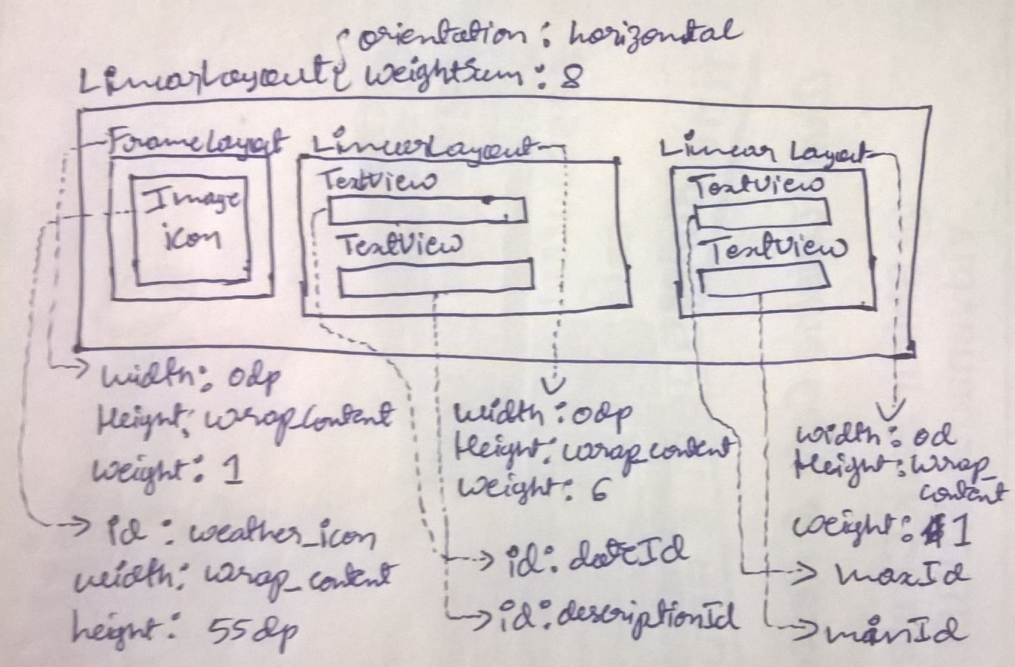
Data Binding Demo
Steps | Instructions
1 | Here we need a listVIew. Therefore create a listItem layout first. i.e res/layout/listview_item_data_binding.xml

Slide 94
Data Binding Demo
Steps | Instructions
2 | Now create a new Activity DataBinding1Activity.class and add a list view its respective layout.
3 | Add following code in to onCreate() method protected void onCreate(Bundle savedInstanceState) { super.onCreate(savedInstanceState); setContentView(R.layout.activity_data_binding1); listView=(ListView)findViewById(R.id.listViewDataBinding1); Uri uri= WeatherContract.WeatherEntry.buildWeatherLocation("6411");//hubli Cursor cursor=getContentResolver().query( uri, null, null, null, null);

Slide 95
Data Binding Demo
Steps | Instructions
3 | String[] fromColumns = {WeatherContract.WeatherEntry.TABLE_NAME+"."+WeatherContract.WeatherEntry.COLUMN_DATE, WeatherContract.WeatherEntry.TABLE_NAME+"."+WeatherContract.WeatherEntry.COLUMN_SHORT_DESC, WeatherContract.WeatherEntry.TABLE_NAME+"."+WeatherContract.WeatherEntry.COLUMN_MAX_TEMP, WeatherContract.WeatherEntry.TABLE_NAME+"."+WeatherContract.WeatherEntry.COLUMN_MIN_TEMP }; int[] toViews = {R.id.dateId, R.id.descriptionId,R.id.maxId,R.id.minId}; SimpleCursorAdapter adapter = new SimpleCursorAdapter(this, R.layout.listview_item_data_binding, cursor, fromColumns, toViews, 0); listView.setAdapter(adapter); }
4 | Before you run this activity, ensure that WeatherProvider and WeatherContaract classes are updated with code(refer GitHub). Then Run the activity

Slide 96
Sample Problem- Data Binding
An activity displays students results as a list where each list item contains students photo, name, usn, semester, and SGP.
Draw the wireframes of list Item layout and activity layout
A content provider URI: content://com.bvbcet/studentmarks/#/* is used to fetch required data.
Populate the listview with the data provided by the content provider
Write the necessary codes.

Slide 97
Sample Problem- Data Contract(sqlite)-chap 4
Consider Faculty Advisors(FA) and students assigned to them. FA name, emailid and cellnum are stored in sqlite database as a table. Also Students name, usn, CGP are stored in an another table with FA emailid as foreign key.
Provide the schema of the tables.
Design and write Data contract classes.
Create your own URI(not content provider class) to
fetch list of students under one FA
details of particular students with usn
Write methods in data contract class to build above URI’s by accepting required parameters.
Include other required static/non-static, constant fields and static/non static methods.

Slide 98
Chapter No. 6. Multi-Touch
Refer lesson plan

